Slide 1


Shot Peening Utilizing ML
CSE583 Software Development for Data Scientists
Creating an accurate and efficient predictive model for shot peening, to enhance precision assembly, reduce material costs, and minimize reliance on physical testing.

Slide 2
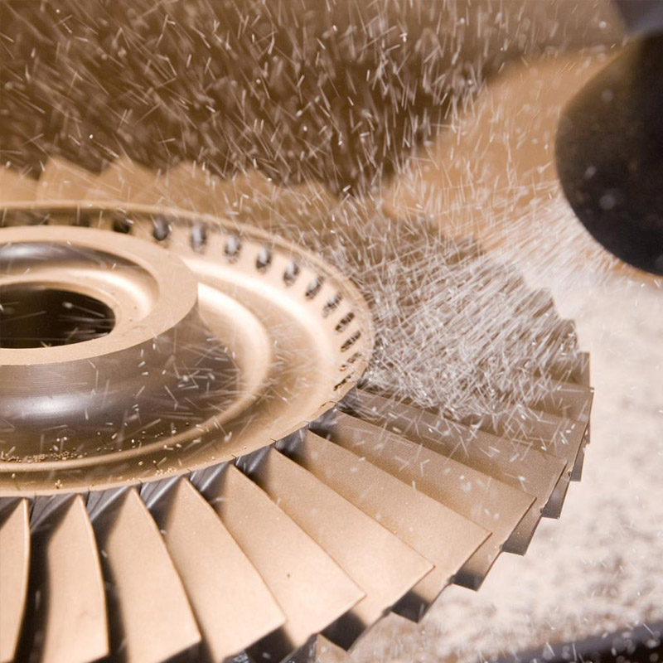
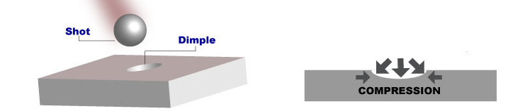
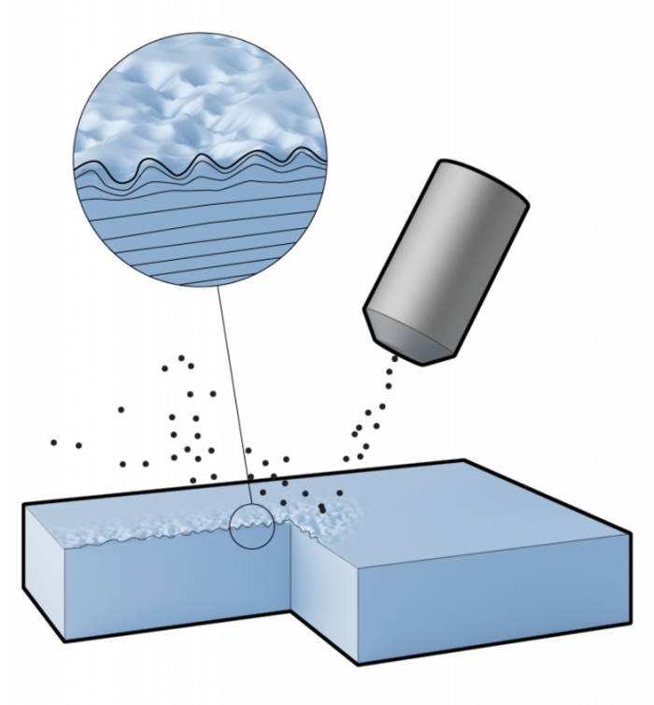
Intro to Shot Peening
University of Washington

Slide 3
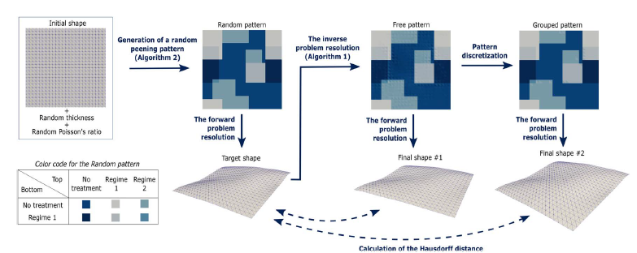
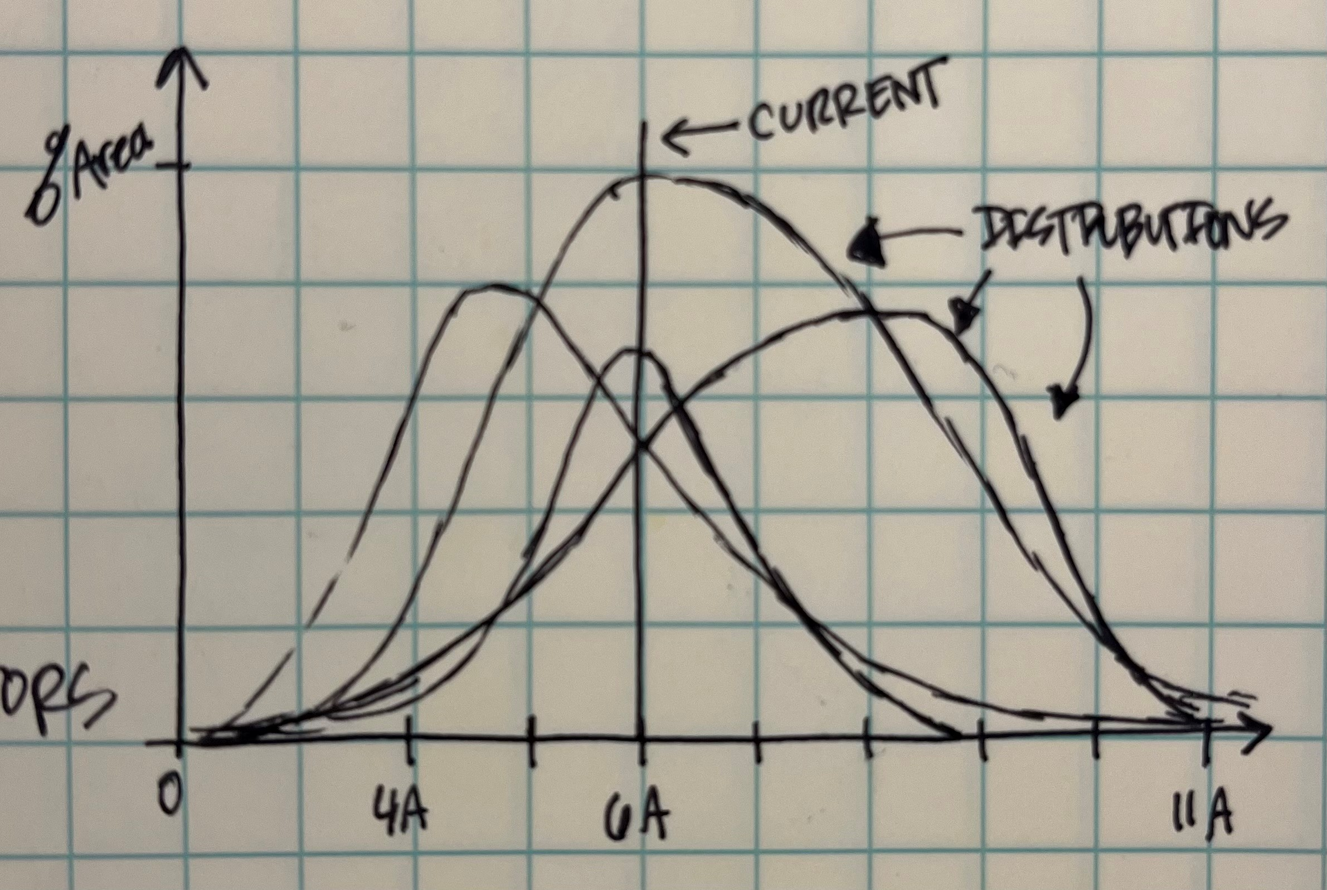
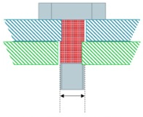
Shot Peening (intro)
Assembly Not Possible
University of Washington

Slide 4
Generating Dataset 1
Where I = shot peen intensity [1A, 2A, …, 11A]
Rand(I)
Rand(I)
Rand(I)
Rand(I)
Rand(I)
Rand(I)
Rand(I)
Rand(I)
Rand(I)
Rand(I)
Rand(I)
Rand(I)
Rand(I)
Rand(I)
Rand(I)
Rand(I)
Repeat 3000 times
University of Washington

Slide 5
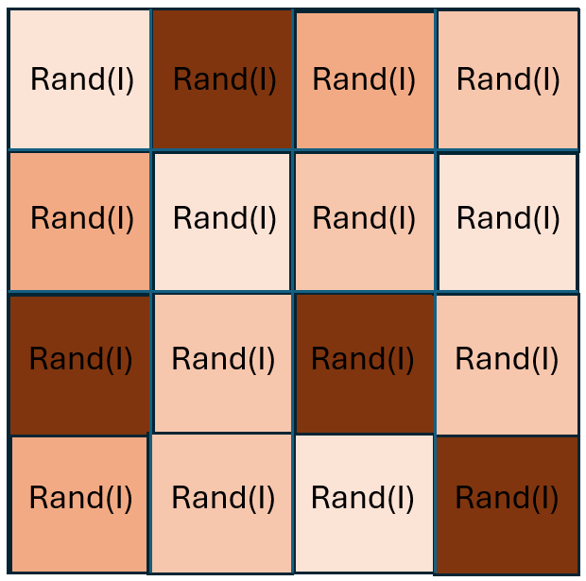
Generating Dataset 2
I = 1A
,
…
I = 2A
,
…
.
.
.
I = 11A
University of Washington

Slide 6
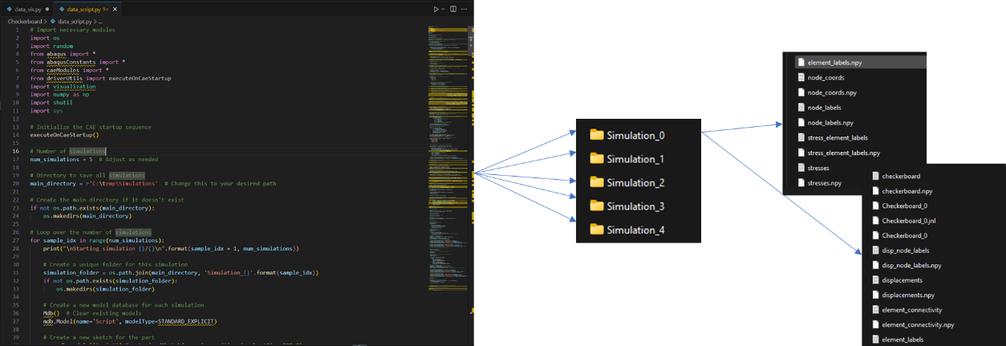
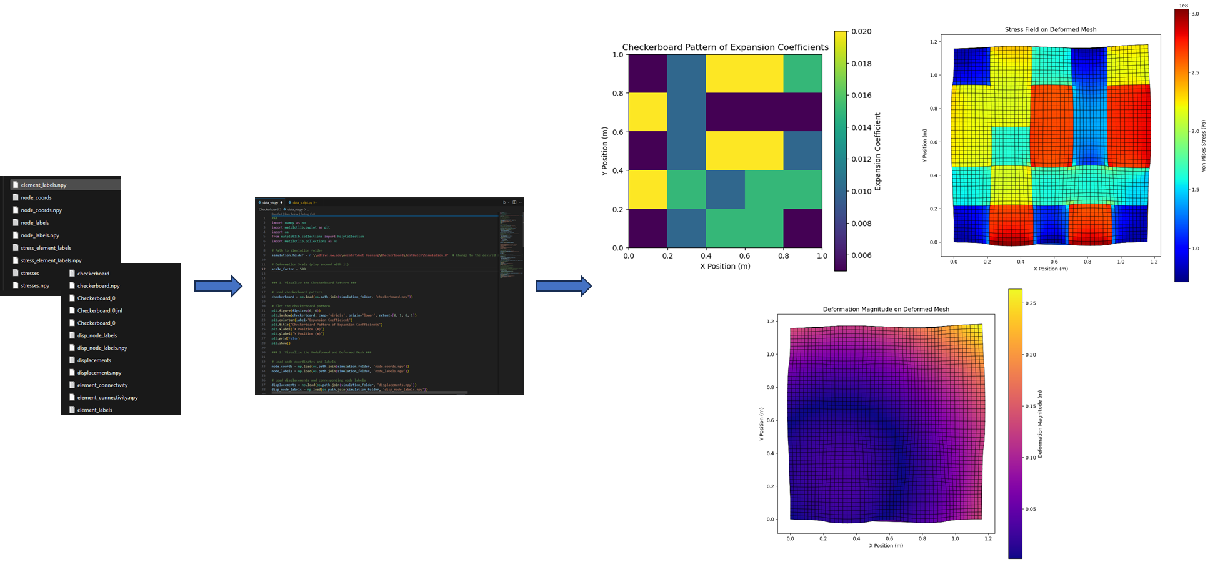
Data Generation & Visualization
Technologies used:
Python
Abaqus
Abaqus Libraries for Python
University of Washington

Slide 7
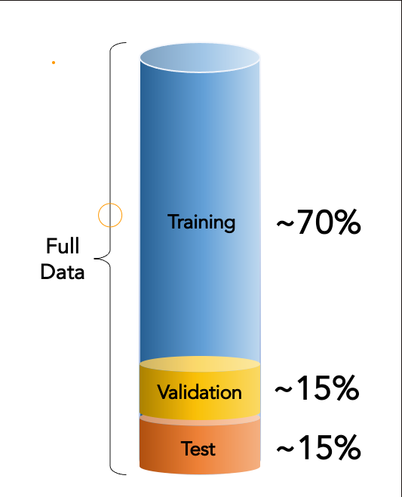
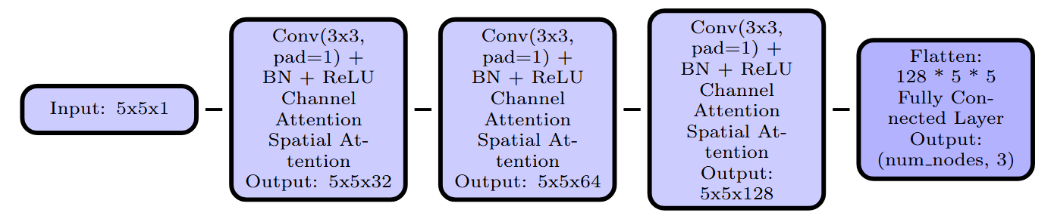
ML model - Convolutional Neural Networks (CNNs)
Dataset: 3082 data points
Loss Function: Mean Squared Error (MSE).
Optimizer: Adam (lr=0.001, weight_decay=1e-5)
Learning Rate Scheduler: StepLR (step_size=2, gamma=0.5)
Evaluation metrics： MSE & sMAPE
Technologies used:
Data Preprocessing
CNNs (Pytorch)
Attention Mechanisms
University of Washington

Slide 8
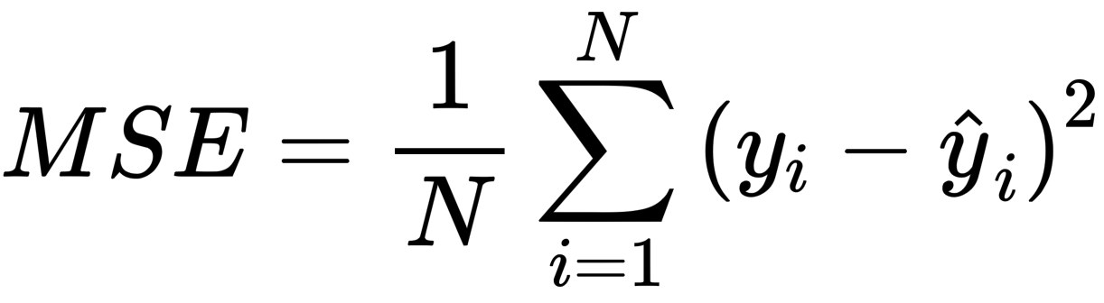
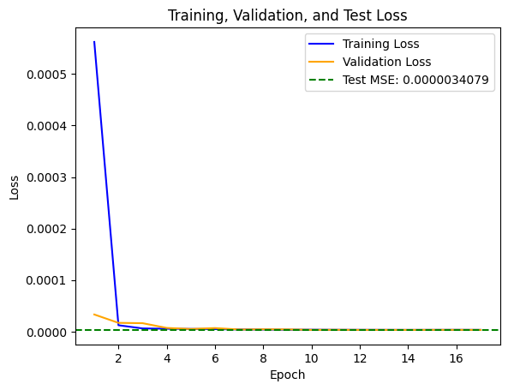
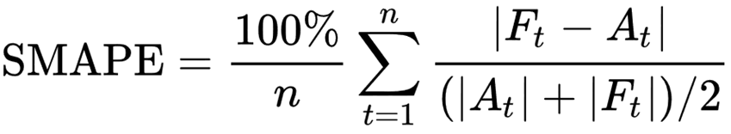
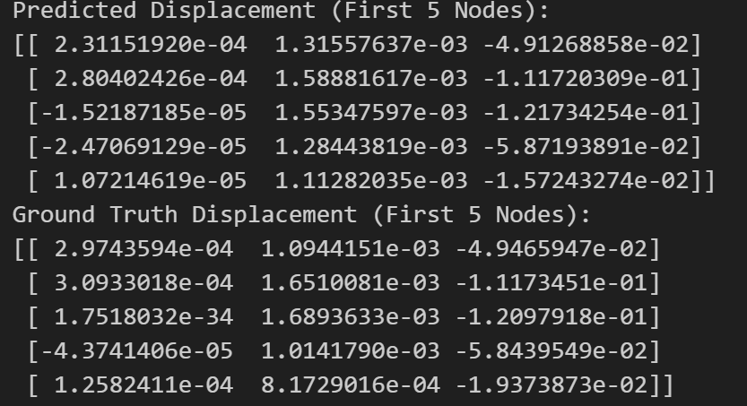
ML model - Convolutional Neural Networks (CNNs)
(1.8 mm off)
MSE: 0.0000034079
sMAPE:20.56%
Lower, Better!
University of Washington

Slide 9
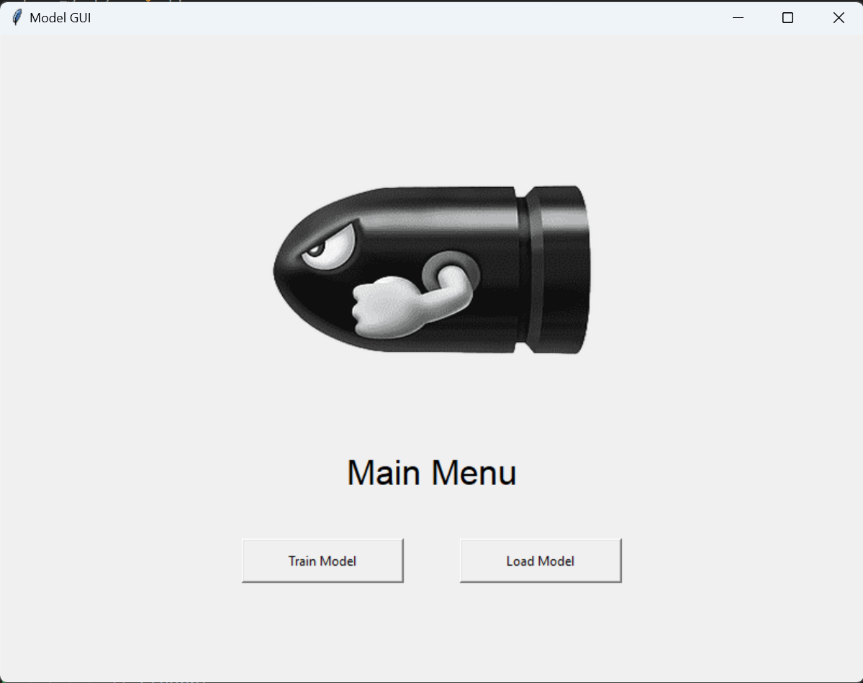
Front End GUI
Technologies used for this part:
Tinker
PIL
Threading & Multiprocessing
University of Washington

Slide 10
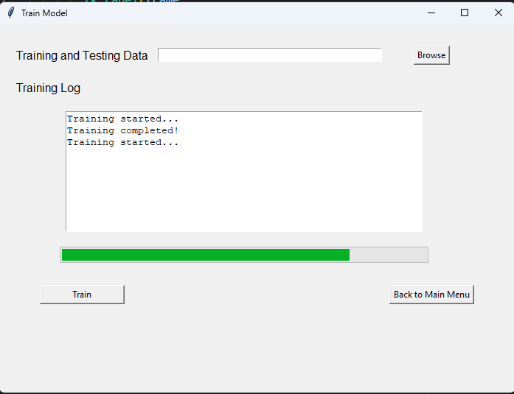
Front End GUI
Technologies used for this part:
Tinker
PIL
Threading & Multiprocessing
University of Washington

Slide 11
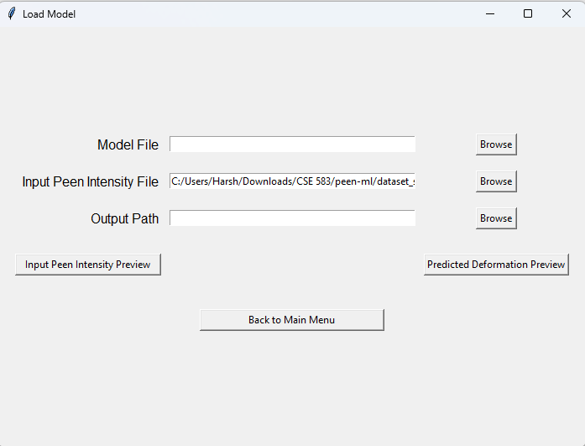
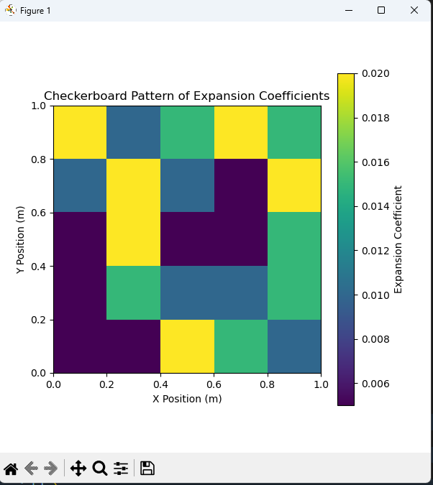
Front End GUI
Technologies used for this part:
Tinker
PIL
Threading & Multiprocessing
University of Washington

Slide 12
Repo Structure
[Repository Root] ── .github/ ── workflows/ ── pylint.yml
├── blueprint/ ── Components.md
│ ├── Describing_a_usecase.md
│ └── User_story.md
├── dataset_sample/ ── dataset1_sample.rar
│ ├── dataset2_sample.rar
│ └── readme.txt.txt
├── src/ ── peen-ml/ ── data_viz.py
│ ├── dataset1_script.py
│ ├── dataset2_script.py
│ ├── model.py
│ ├── model_notebook_v2.ipynb
│ └── model_notebook_v3.ipynb
├── tests/ ── simulation_0
│ ├── simulation_1
│ ├── test_Shotpeen_Gui.py
│ ├── test_data_viz.py
│ └── test_model.py
├── .gitignore
├── LICENSE
├── README.md
├── pyproject.toml
└── shotpeen_gui.py
User Driven Approach
Dataset Sample
Scripts
Test Driven Development
GUI
University of Washington

Slide 13
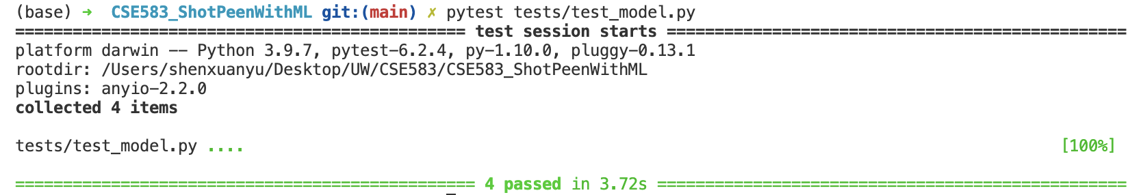
Tests
Example: Tests for ML Model
Smoke test
check if the function runs without errors
One-shot test
Check basic functionality of CheckerboardDataset
Check if ChannelAttention layer can forward a tensor
Edge test
Test load_all_npy_files with a missing file
Data Visualization
Smoke Test
Tests
ML Model
One-shot Test
GUI
Edge Test
University of Washington
Notes:
Tests for Data Visualization
Smoke test:
verify load_data runs without errors
One-shot test:
Test compute_deformed_mesh with correct data
Test load_data with an invalid file
Edge test
Test compute_deformed_mesh when a required file is missing
Test load_data with an empty file
Tests for GUI
Smoke test
ensure check_install does not throw exceptions
One-shot test
Test that get_file_path correctly joins base and relative paths
Test preview_file behavior with valid and invalid file paths
Edge test
Test check_install with a non-existent package
Test browse_file when no file is selected
Test browse_directory when no directory is selected

Slide 14




Challenges Faced
Improve model accuracy
Dependency issues
Front-end back-end integration
os.path? Absolute or relative
Int8, Bool8? Who's that?
University of Washington

Slide 15
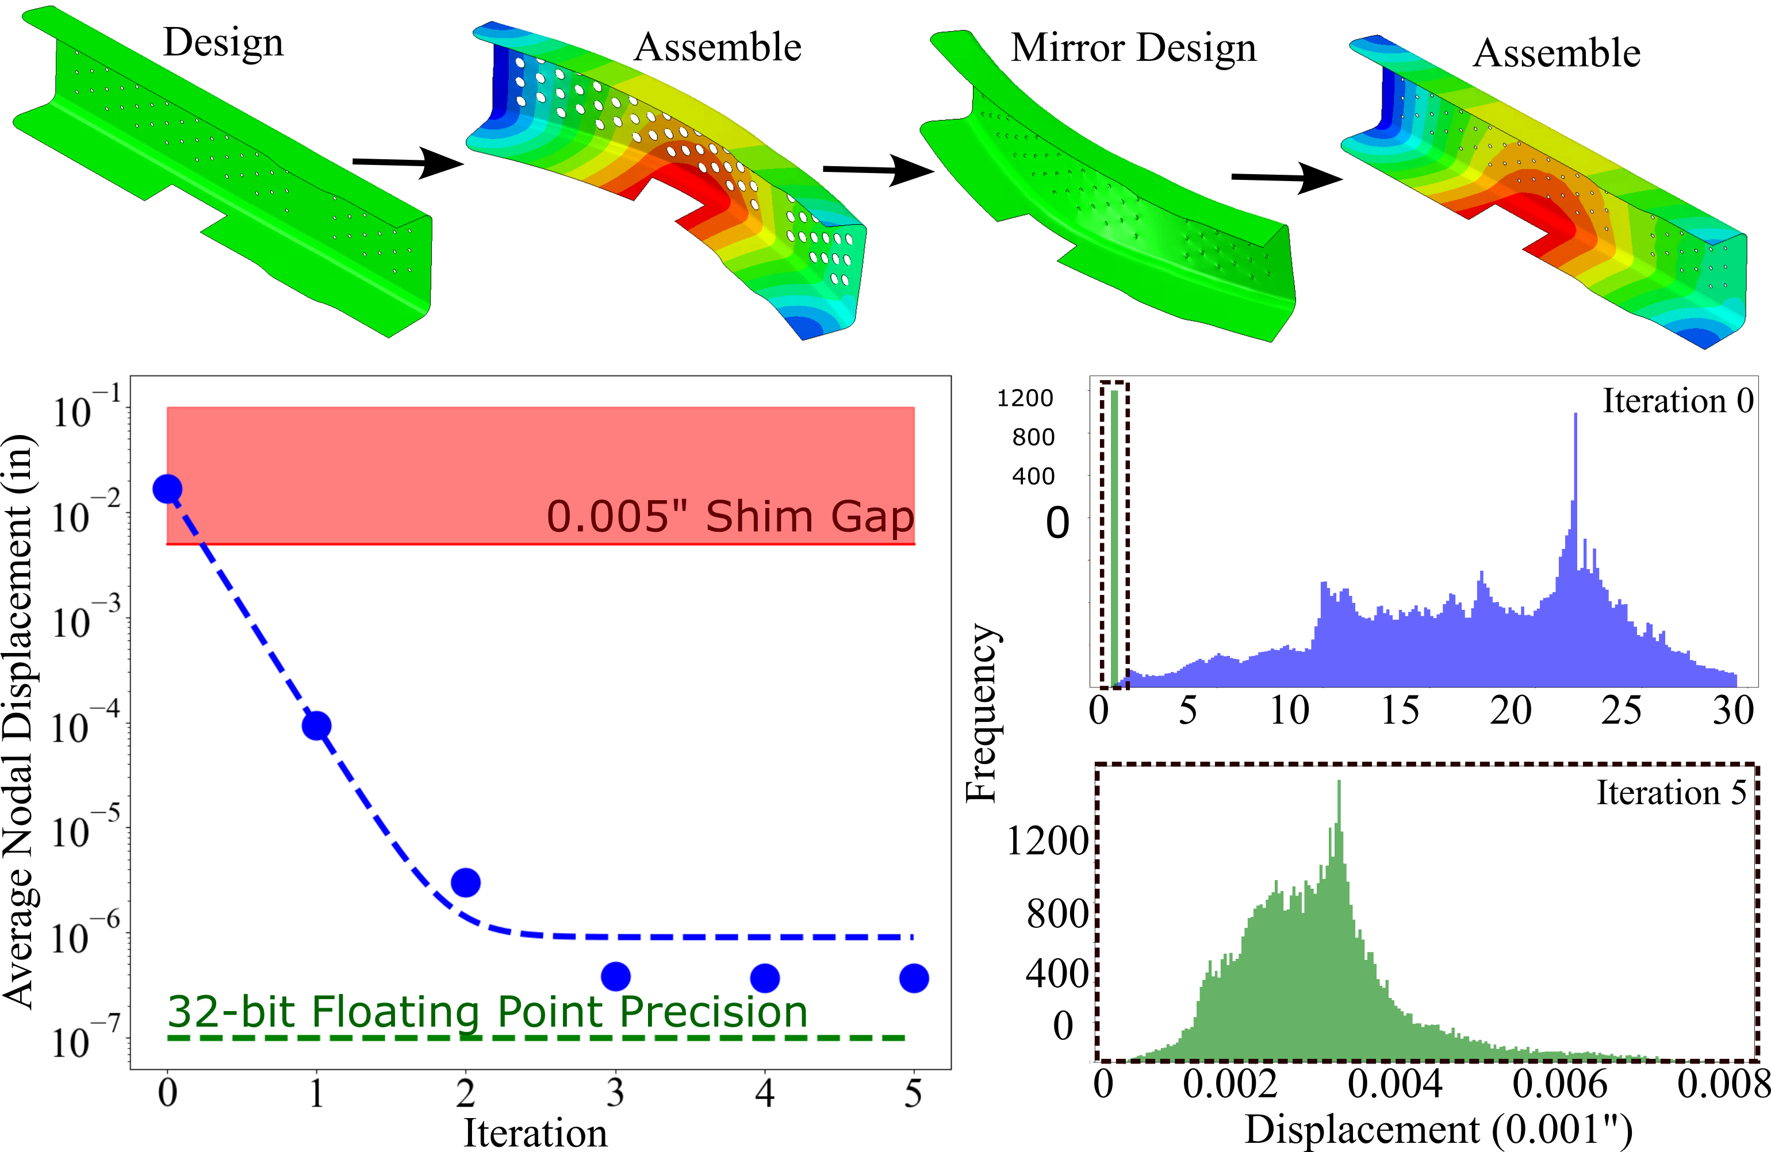
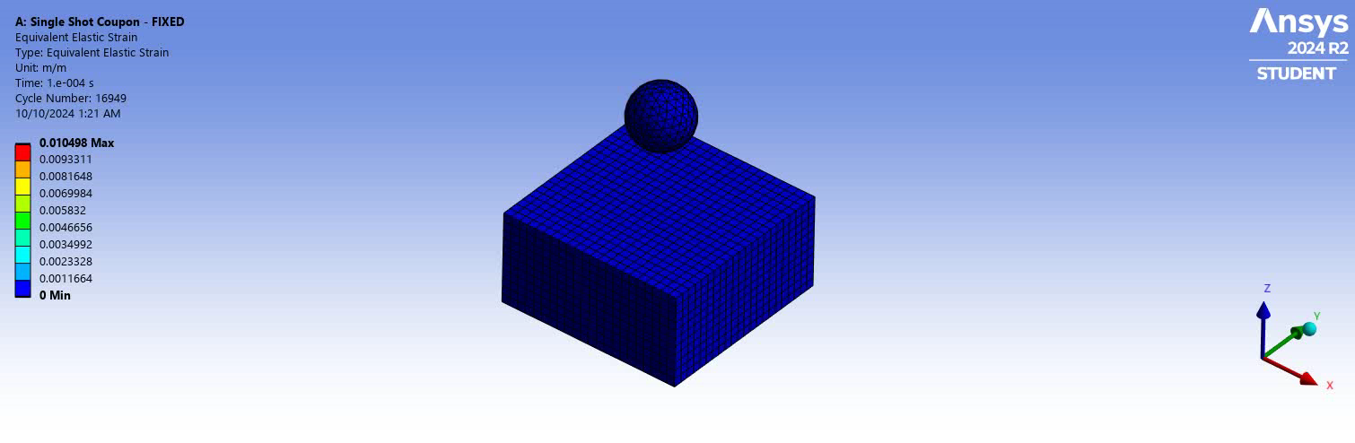
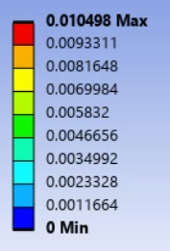
Future Steps
Improve model accuracy
Generalize model to not only flat plate by incorporating 3D simulations
Design Inverse Problem
Experimental Validation
1.
2.
…
n
University of Washington

Slide 16

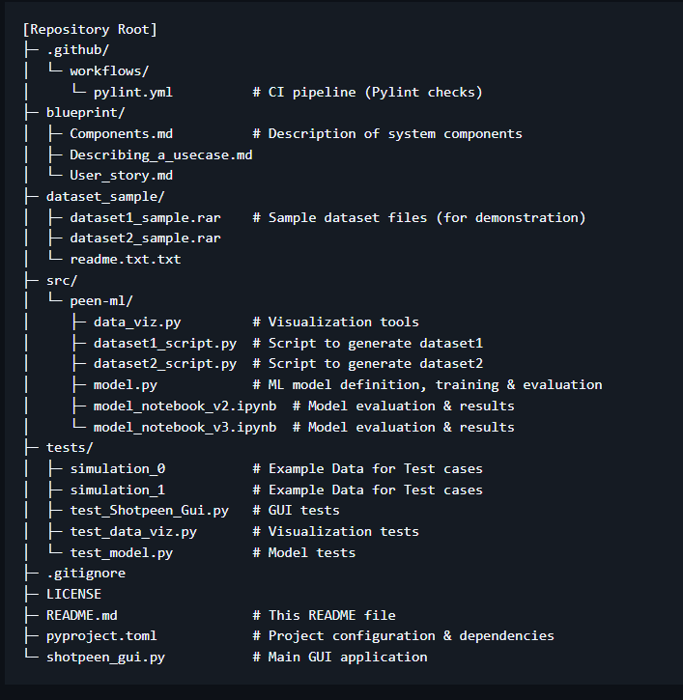
Summary Slide
Open
Source
Create Dataset
Build/Train ML Model
Design Inverse Problem
Package
(Pending)
Abaqus Scripting
University of Washington

